Slide 1

COMP90050:
Advanced Database Systems
Lecturer: Farhana Choudhury (PhD)
Query costs in practice
Week 2

Slide 2
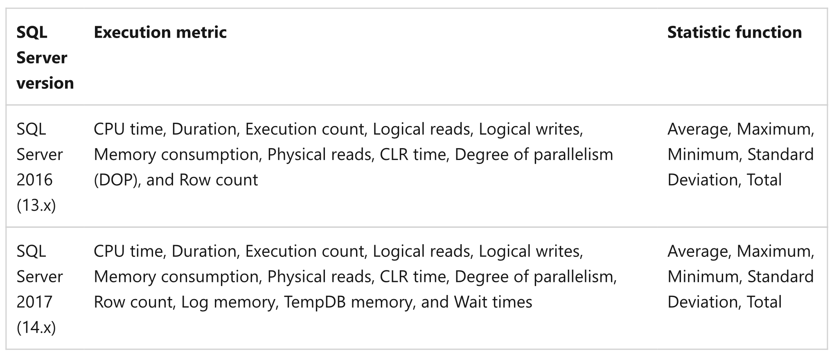
Query costs – in practice
SQL server management studio for monitoring - Query Store
Source: https://docs.microsoft.com/en-us/sql/relational-databases/performance/best-practice-with-the-query-store?view=sql-server-ver16#Insight
Notes:
Query performance insight

Slide 3
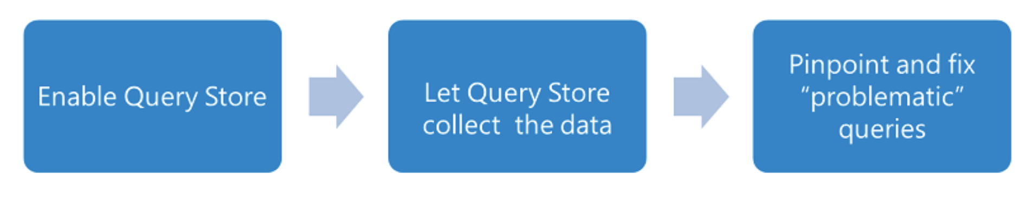
Query costs – in practice
Troubleshooting to manage costs
Identify ‘regressed queries’ - Pinpoint the queries for which execution metrics have recently regressed (for example, changed to worse).
Track specific queries - Track the execution of the most important queries in real time.
Source: https://docs.microsoft.com/en-us/sql/relational-databases/performance/best-practice-with-the-query-store?view=sql-server-ver16#Insight
Notes:
Query performance insight. Typically, use it when you have queries with forced plans and you want to make sure that query performance is stable.

Slide 4
Query costs – in practice
When you identify a query with suboptimal performance
Force a query plan instead of the plan chosen by the optimizer
Do we need an index?
Enforce statistic recompilation
Rewrite query?
Source: https://docs.microsoft.com/en-us/sql/relational-databases/performance/best-practice-with-the-query-store?view=sql-server-ver16#Insight
Notes:
Query performance insight

Slide 5
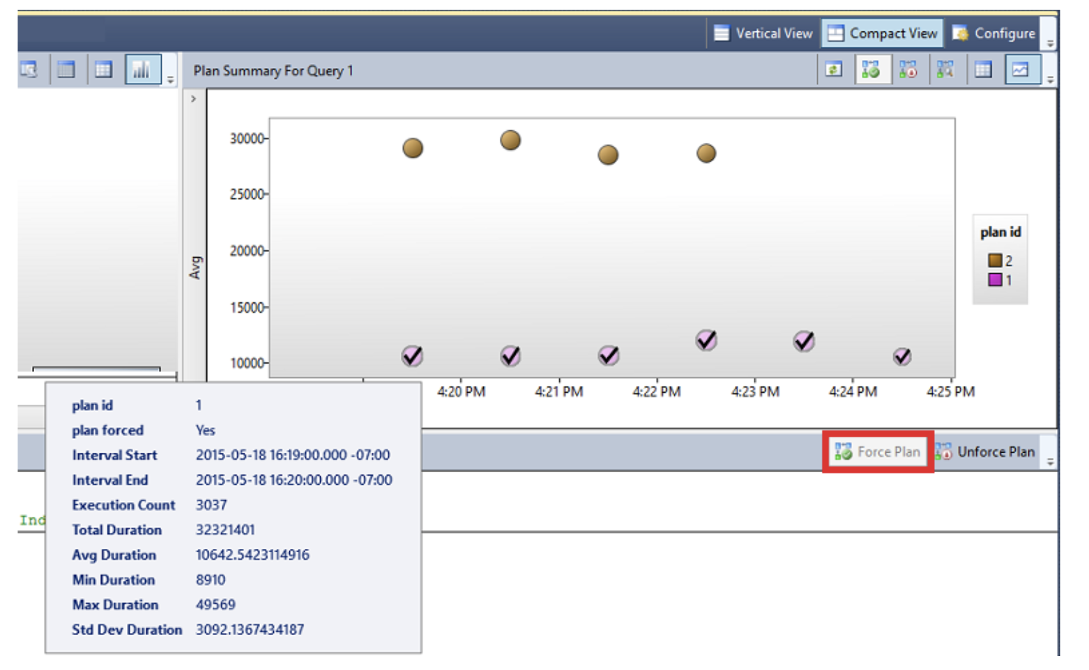
Query costs – in practice
When you identify a query with suboptimal performance
Force a query plan instead of the plan chosen by the optimizer
Source: https://docs.microsoft.com/en-us/sql/relational-databases/performance/best-practice-with-the-query-store?view=sql-server-ver16#Insight
Notes:
Query performance insight

Slide 6
Query costs – in practice
Query rewriting with parameters for execution plan reuse
We expect the optimizer to generate essentially the same plan and reuse the plans - parameterize
SELECT *
FROM Product
WHERE categoryID = 1;
SELECT *
FROM Product
WHERE categoryID = 4;
DECLARE @MyIntParm INT
SET @MyIntParm = 1
EXEC sp_executesql
N'SELECT -
FROM Product
WHERE categoryID = @Parm',
N'@Parm INT',
@MyIntParm
Source: https://docs.microsoft.com/en-us/sql/relational-databases/query-processing-architecture-guide?view=sql-server-ver16#parameters-and-execution-plan-reuse
Notes:
Query performance insight

Slide 7
Can we further lower query costs?
Store derived data
  When you frequently need derived values
  Data do not change frequently
Use pre-joined tables
  When tables need to be joined frequently
  Regularly check and update pre-joined table for updates in the original table
  May still return some ‘outdated’ result

